Slide 1

The Freq: Reimagine Wellness in Kalamazoo
The Freq is revolutionizing wellness in Kalamazoo with immersive frequency experiences for a healthier community. Using cutting-edge technology, we aim to provide unique and effective solutions for stress relief and overall well-being, catering to diverse needs within the local area.
FW
by Final Wellness

Slide 2

Kalamazoo, We Have a Stress Problem
High stress levels are impacting our community's health and well-being.
Local residents are seeking effective, accessible, and enjoyable stress-relief solutions.
Traditional methods often fall short, leaving a gap in the market.
35% of Kalamazoo County residents report experiencing frequent mental distress.
High stress levels significantly affect Kalamazoo's residents, prompting a need for effective and accessible stress-relief solutions. Traditional methods often fail to meet these needs, leaving a gap in the market. The Freq addresses this issue by providing immersive, frequency-based wellness experiences that are both enjoyable and beneficial.

Slide 3
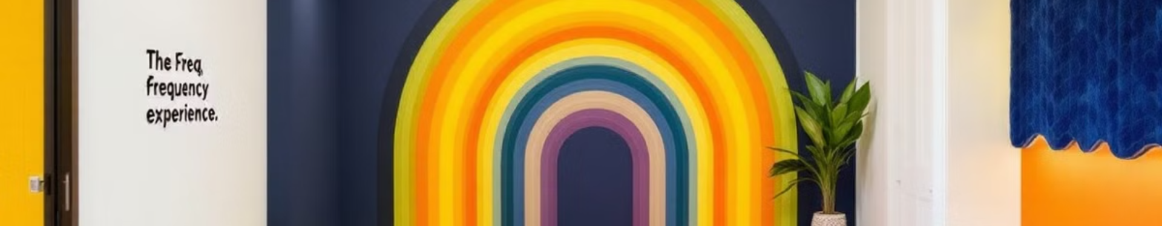
Introducing The Freq: A New Approach to Well-being
The Freq is a groundbreaking wellness center located in downtown Kalamazoo, offering immersive frequency-based experiences. We utilize a combination of sound, vibration, light, and biofeedback to foster relaxation, enhance focus, spark creativity, and foster deeper connection. Our comprehensive, multi-sensory approach is specifically designed to be both enjoyable and deeply beneficial, helping individuals unlock their full potential.
Our goal is to help every individual in Kalamazoo reach their full potential through innovative and accessible wellness solutions. We aim to be a cornerstone of well-being in the community.

Slide 4
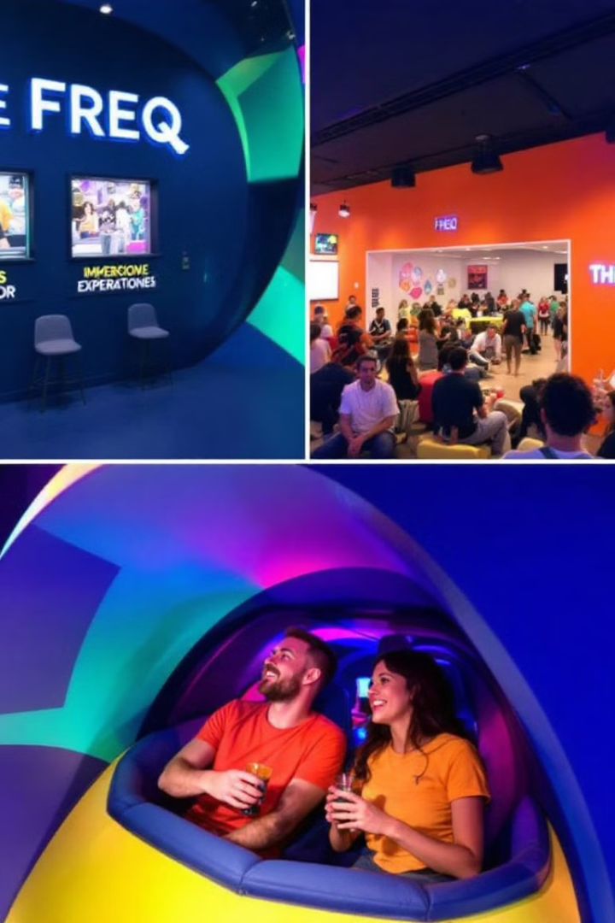



A Journey Through Frequency
The Grounding Frequency
Deep relaxation and stress reduction through calming soundscapes, gentle vibrations, and warm lighting. Features binaural beats to promote delta and theta waves.
The Creative Current
Enhanced focus and creative thinking with energizing lighting, focused workstations, and noise-canceling headphones. Utilizes beta and gamma wave binaural beats and isochronic tones.
The Sonic Surge
Social connection and euphoric experiences featuring dynamic lighting, vibration platforms, and high-fidelity sound with rhythmic patterns and curated playlists.
Each floor of The Freq offers a distinct experience tailored to different wellness goals. From deep relaxation to creative enhancement and social connection, there is something for everyone.

Slide 5

Backed by Science, Driven by Results
1
Brainwave Entrainment
2
Proven Therapies
The Freq utilizes scientifically validated principles of brainwave entrainment. Brainwave entrainment is a method of syncing brainwaves to specific frequencies through auditory or visual stimuli.
Binaural beats, isochronic tones, and vibroacoustic therapy have been shown to reduce anxiety, improve focus, and promote relaxation.
3
Safe and Customizable
Our technology is safe, non-invasive, and customizable, allowing each experience to be tailored to individual needs.
We are committed to ongoing research and data collection to optimize our experiences, ensuring maximum benefit for our clients. Science backs all of our practices.

Slide 6




Meeting Kalamazoo's Growing Wellness Needs
The Kalamazoo wellness market is a rapidly expanding $200M market.
Our target demographics include students, young professionals, families, and wellness-conscious individuals.
There is limited direct competition in Kalamazoo for frequency-based wellness experiences, making The Freq a unique offering.
We see strong potential for partnerships with local businesses and organizations to expand our reach and impact within the community. Kalamazoo is in need of something new and exciting like The Freq.

Slide 7

A Sustainable and Scalable Model
Tiered Memberships
Recurring revenue through tiered membership options tailored to different needs and budgets.
Individual Sessions
Flexibility through individual session bookings, catering to those who prefer occasional visits.
Wellness Services
Specialized wellness center services addressing specific needs such as stress management and focus enhancement.
Workshops and Retreats
Immersive experiences through workshops and retreats, fostering deeper engagement and community.
Our sustainable business model ensures long-term viability and allows for scalability as we grow within Kalamazoo and beyond.

Slide 8
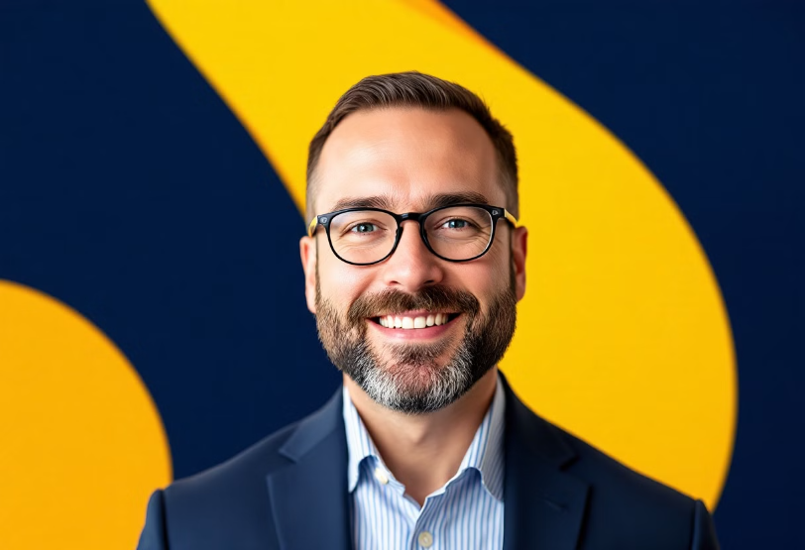
Meet the Team
The Freq is led by Marc Tuinier, a Kalamazoo resident with a passion for wellness and a proven track record in business management and community engagement. Our team combines expertise in operations, audio engineering, and wellness services, ensuring a holistic and effective approach.
We are committed to building a strong, local team and creating jobs in Kalamazoo, contributing to the economic well-being of our community.
Our Kalamazoo-based team is dedicated to bringing innovative wellness solutions to our community, driving positive change and growth.

Slide 9
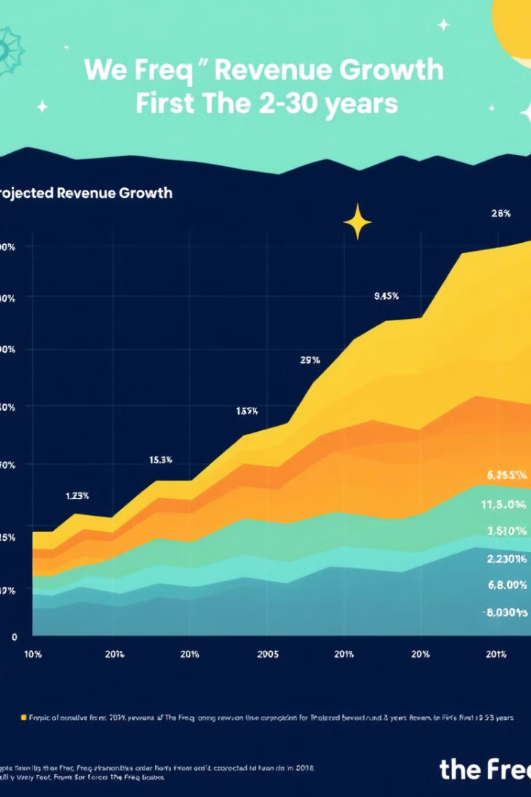
Investing in Kalamazoo's Well-being
1
Seed Funding
Seeking $365,000 in seed funding to launch our flagship facility in downtown Kalamazoo.
2
Location
Open a location with the best sound, light and vibration equipment, in the best possible area.
3
Local Team
The Freq will have a strong, local team with deep ties to the community.
Key financial projections include achieving break-even within the first 18 months and significant revenue growth in Year 2, driven by strong local demand.

Slide 10

Join Us in Building a Healthier Kalamazoo
We invite you to partner with us in bringing this transformative vision to life. Together, we can make Kalamazoo a leader in wellness innovation and create a positive impact on our community.
Contact us to learn more and discuss investment opportunities. Email: investors@thefreq.com. Phone: (269) 555-WELL
With your support, The Freq can become a cornerstone of wellness in Kalamazoo, improving the lives of countless individuals. We want to give back to the community with your help.

